Slide 1
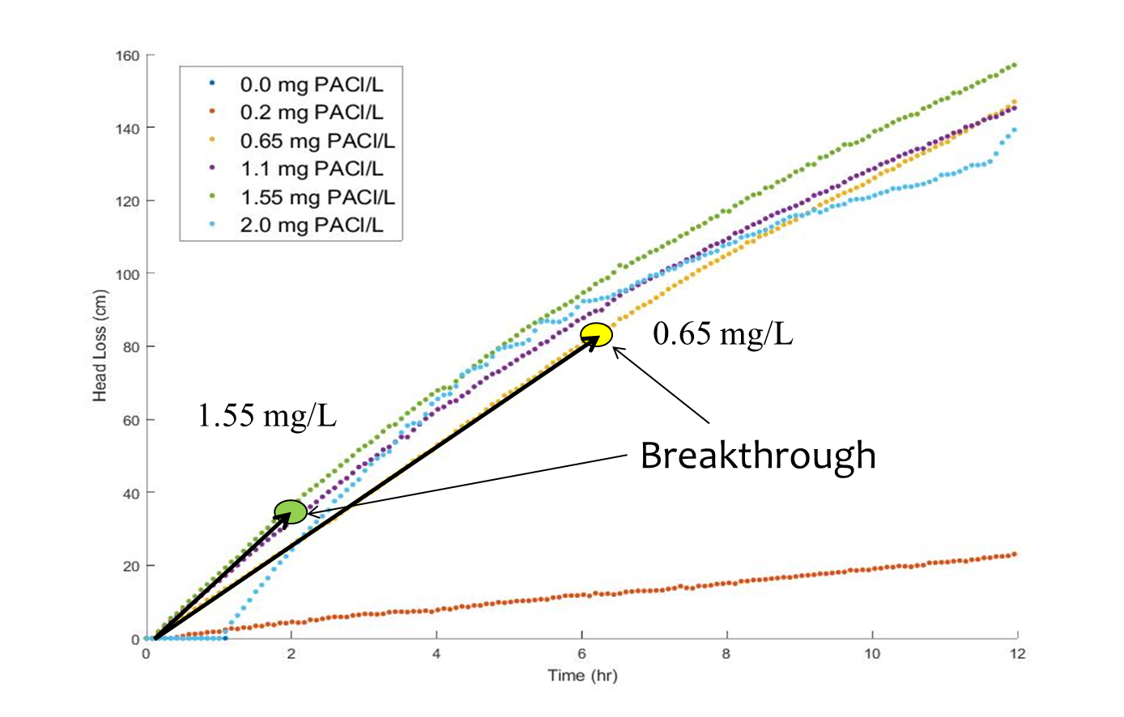
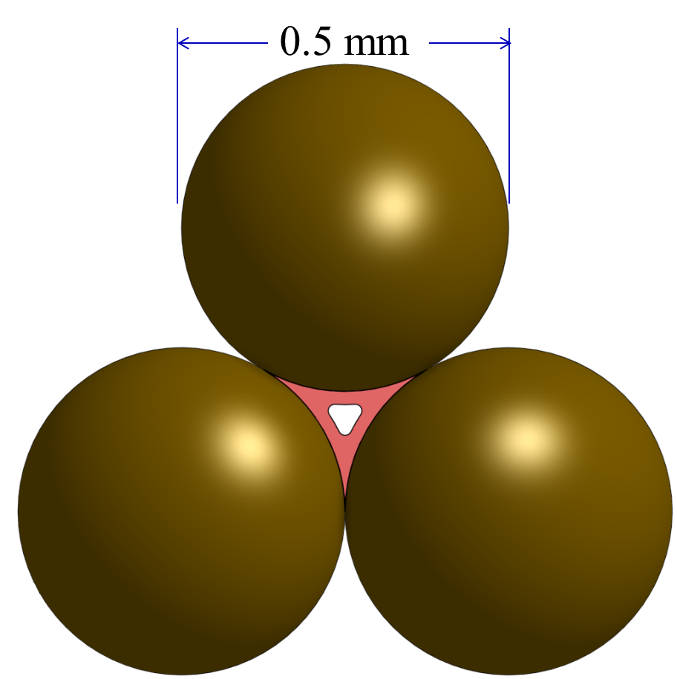
The great Filtration Mystery
Head loss through the filter increases close to linearly with time
But if we look at a pore and think about how it contacts as particles deposit we would expect head loss to increase at an increasing rate as the pore constricts
So why does head loss increase linearly with time?

Slide 2
If a sand filter is 20 cm deep and the sand grains are 0.5 mm in diameter…
How many sand grains does the water flow past (or how many pores does it flow through) on its way through the filter? (Ignore how the sand packs and assume that each sand grain occupies a little cube)
Note that there is 1 pore or flow constriction per sand grain in a filter
Hint the number of sand grains is a dimensionless number. You have two lengths! How can you get a dimensionless result?

Slide 3
If the head loss for water flowing through one “clogged” sand pore is 1 mm…
How much head loss will there be when all the pores are clogged?
How much head loss will there be when half of the pores are clogged?
Remember head loss adds when in series (but now when in parallel) . Head loss is like voltage drop across a resistor.

